Slide 1
Project – 6 : Sales Forecasting Across Multiple Retail Stores
Company Name:- Next Hikes IT Solution
Ashish Pachauri

Slide 2
Project Overview
To develop and deploy an end-to-end machine learning solution that forecasts daily sales for retail stores across multiple cities up to six weeks in advance.
Business Problem
Currently, store managers rely on personal experience and judgment to forecast sales, which may not be optimal. The finance team requires accurate sales predictions to make informed business decisions and resource planning across various store locations.
Project Objectives
The project is structured into three main components
1. Exploratory Data Analysis (Task 1)
.Customer Behavior Analysis: Understanding purchasing patterns across different stores.
.Data Cleaning & Preprocessing: Building pipelines to handle outliers and missing data.
.Feature Analysis: Examining factors like promotions, holidays, seasonality, competition, and store characteristics.

Slide 3
Key to Explore:
Impact of promotions on sales and customer acquisition
Seasonal purchasing behaviors (Christmas, Easter, etc.)
Correlation between sales and customer numbers
Effect of competition distance on store performance
Store opening patterns and weekend sales impact
2. Predictive Modeling (Task 2)
Traditional ML Approach: Using sklearn pipelines with tree-based algorithms (Random Forest)
Deep Learning Approach: Implementing LSTM neural networks for time series forecasting
Feature Engineering: Creating temporal features from datetime columns
Model Evaluation: Custom loss function selection and performance analysis
MLOps Implementation: Model serialization, versioning, and MLFlow integration
3. Web Application Development (Task 3)
Frontend Interface: User-friendly dashboard
Backend Development: Model inference using Streamlit
Input Parameters: Store ID, date, holiday indicators, promotion status
Output Features: Predicted sales amounts, customer numbers, and downloadable CSV reports

Slide 4
Dataset Features
The dataset includes comprehensive information about
Store Information: Store ID, type, assortment level
Sales Data: Daily turnover and customer counts
Temporal Factors: Dates, holidays, school holidays
Promotional Activities: Regular promos and consecutive promotional campaigns
Competition Data: Distance and opening dates of nearest competitors
Technical Stack
Programming: Python (Pandas, NumPy, Matplotlib)
Machine Learning: Scikit-learn, TensorFlow
MLOps: MLFlow for model tracking and serving
Web Development: Streamlit, HTML, CSS
Software Used: jupyter notebook, VS Code
Expected Outcomes
Business Impact: 6-week ahead sales forecasting capability for better resource planning
Technical Deliverables:
Comprehensive EDA notebook with insights
Production-ready ML models with performance metrics
User-friendly web application for predictions
Complete MLOps pipeline for model management

Slide 5
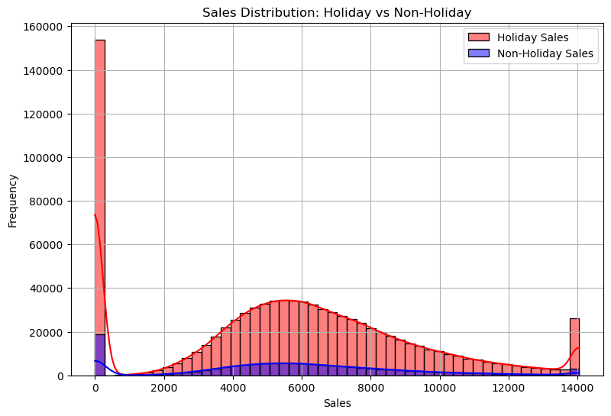
Task 1 - Exploration of customer purchasing Behaviour
Customer purchasing behaviour refers to the decision-making processes and actions that individuals or groups undertake when selecting, buying, using, or disposing of products and services. Understanding this behaviour is crucial for businesses aiming to tailor their marketing strategies, improve customer satisfaction, and boost sales.
Sales Distribution: Holiday vs Non-Holiday
Holiday Sales (Red bars/line): The highest number of sales entries is clustered around ₹0, which may indicate a large number of transactions with no recorded revenue—possibly due to heavy discounts, returns, or data entry issues. There's also a noticeable spike around ₹6,000, suggesting a group of customers making relatively high-value purchases during the holidays.
Non-Holiday Sales (Blue bars/line): The pattern is somewhat similar but generally shows slightly lower frequencies. This implies that while customers also spend during non-holiday periods, the intensity and frequency of purchases are not as high as during holidays.

Slide 6
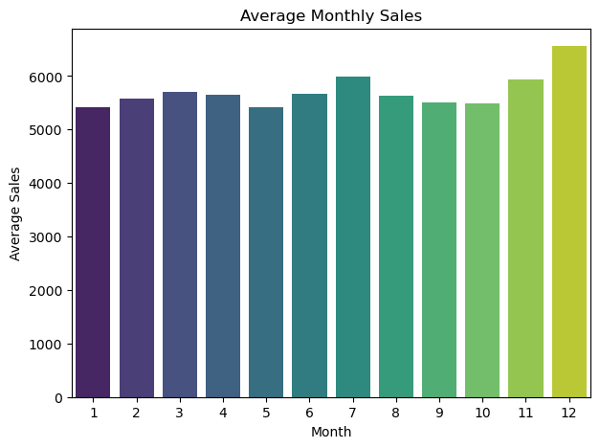
Average Monthly Sales
Insight:
This bar chart, titled Average Monthly Sales, displays the trend of average sales across each month from January (1) to December (12). The y-axis represents the average sales amount, scaling from ₹0 up to ₹7,000.
Highest Average Sales: December stands out with the bright yellow bar, indicating the peak of sales activity possibly driven by holiday shopping or end-of-year promotions.
Lowest Average Sales: May records the lowest sales with a darker bar, suggesting a seasonal dip or off-peak customer activity.
Gradual Trend: The months leading to December show a general upward movement in sales, hinting at increasing customer engagement or seasonal campaigns as the year progresses.
Marketing Focus: Leverage data-driven campaigns pre-December and address underperforming months with creative initiatives.
Customer Segmentation: Consider timing discounts based on buyer categories early planners vs last-minute shoppers.

Slide 7
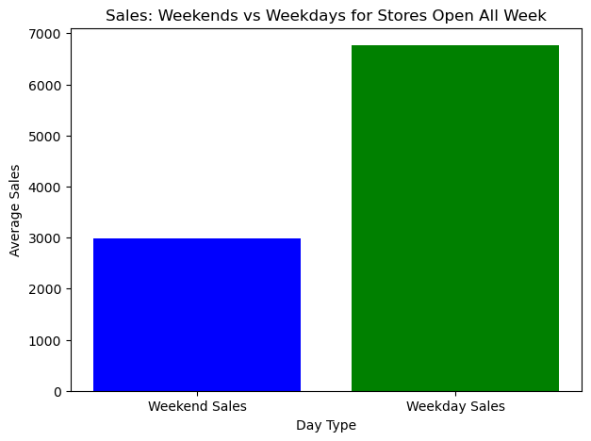
Sales: Weekends vs Weekdays for Stores Open All Week
Weekday Sales (Green Bar): Significantly higher, averaging around ₹7,000. This indicates strong consumer activity during weekdays, possibly driven by regular shopping routines, working professionals making purchases during lunch breaks, or weekday discounts.
Weekend Sales (Blue Bar): Lower, averaging about ₹3,000. This suggests reduced sales over the weekend, which may seem counterintuitive but could be influenced by factors like fewer store visits, reduced operational hours, or customers preferring online purchases when they’re at home.
Weekday Strength (₹7,000+)
The higher average sales during weekdays could be attributed to habitual shopping routines, such as professionals buying essentials during commutes or lunch breaks.

Slide 8
Task 2 - Prediction of store sales
Predicting store sales is a critical task in retail analytics that helps businesses make informed decisions about inventory management, staffing, marketing, and revenue forecasting. With the rise of data-driven strategies, sales prediction has evolved from simple trend analysis to sophisticated machine learning models.
Sales predictions rely on a variety of features, including:
Historical Sales Data, Store Type and Location ,Promotions and Discounts ,Holiday and Seasonal Effects ,Day of the Week / Month ,Weather Conditions ,Competitor Activity.
Implement streaming data pipelines using tools like Kafka or Spark to update predictions dynamically.
Techniques Used:
Time Series Analysis
Regression Models
Machine Learning Algorithms (e.g., Random Forest)

Slide 9
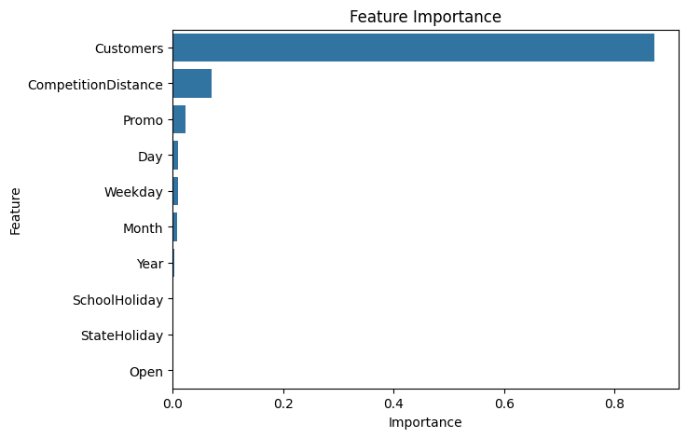
Feature Importance
Customers: This feature dominates the chart, with an importance score near 1.0. It means that the number of customers visiting a store is by far the strongest predictor of sales which is intuitive, as more footfall usually correlates with more revenue.
Competition Distance: The second most influential factor. Stores located farther from their competitors may have a competitive advantage, which contributes positively to sales prediction.
Promo: Active promotions also play a noticeable role, but not as dominant as expected—possibly due to interactions with other features like holidays or customer volume.

Slide 10
Top 10 features
Feature | Important
Customers | 0.871617
CompetitionDistance | 0.070869
Promo | 0.023111
Day | 0.010500
Weekday | 0.009877
Month | 0.008830
Year | 0.003530
SchoolHoliday | 0.001463
StateHoliday | 0.000204
Open | 0.000000

Slide 11
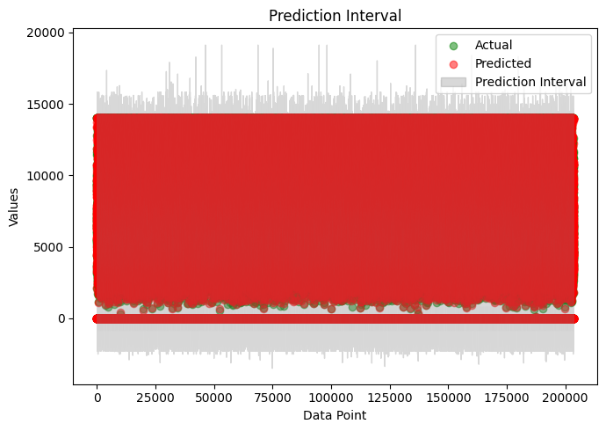
Prediction Interval
The chart visualizes the comparison between actual sales values and predicted sales values along with the prediction interval for each data point in the dataset.
Green Dots: Represent the actual store sales data points.
Red Dots: Show the predicted sales values generated by the forecasting model.
Gray Area: Indicates the prediction interval, which provides a range within which the actual sales are expected to fall with a certain level of confidence.
The model predictions (red dots) closely follow the actual values (green dots), suggesting a reasonable prediction performance.
The wide gray interval shows the uncertainty in prediction across all data points. In this chart, the interval appears quite broad, indicating high variability or model uncertainty.
A large dataset is used, as shown by the high number of data points on the X-axis (up to 200,000).

Slide 12
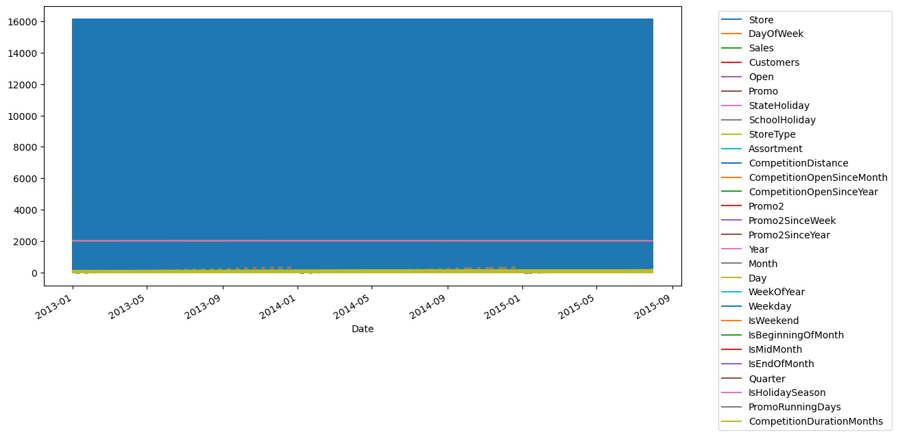
Task - 2.6 Building model with deep learning
Data in Timeseries
Breakdown of the Components
X-Axis (Horizontal): Time series axis starting from Jan 2013 to Sep 2015.
Y-Axis (Vertical): Scaled or normalized values of different features.
Stacked Layers: Each layer represents a feature from the dataset such as:
Core performance metrics: Sales, Customers, Promo, Open
Holiday indicators: SchoolHoliday, StateHoliday
Store-level characteristics: StoreType, Assortment, CompetitionDistance, Promo2, etc.
Time-related variables: Month, WeekOfYear, Quarter, Year, IsWeekend
Promotional campaigns: Promo2SinceWeek, PromoRunningDays
Competition timing and duration: CompetitionOpenSinceMonth, CompetitionDurationMonths

Slide 13
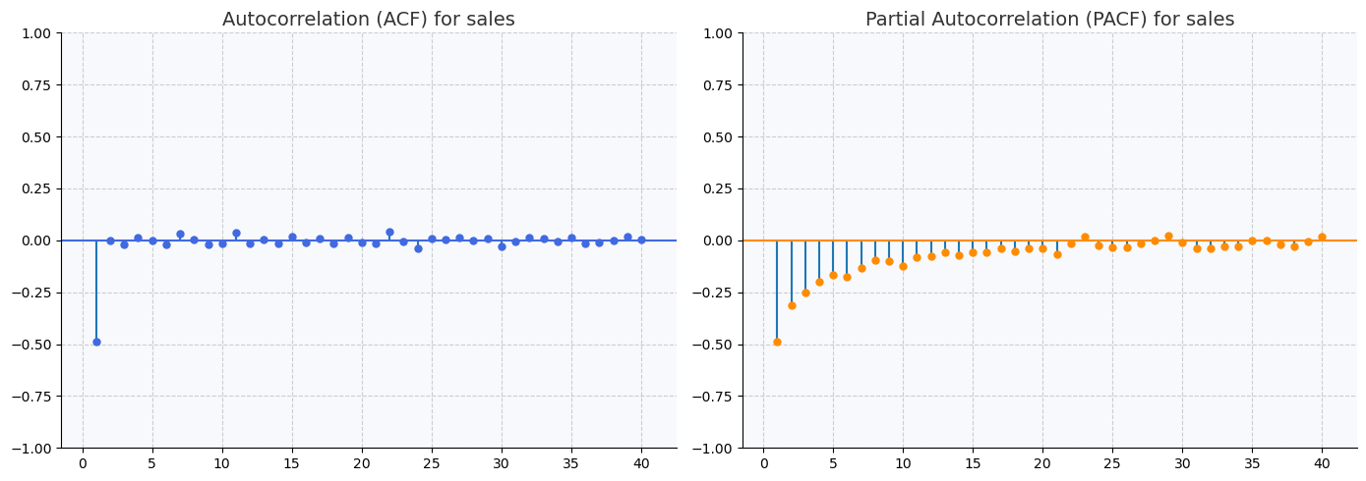
Autocorrelation and Partial Autocorrelation
Left Plot: Autocorrelation Function (ACF)
Purpose: Measures the correlation between current sales and its past values at different time lags.
Key Observations:
Lag 1: Strong negative autocorrelation (~ -0.5), meaning if sales were high at time t, they tend to drop at time t+1.
Lags 2–40: Most fall within the confidence interval (dashed blue lines), suggesting no significant autocorrelation after lag 1.
📘 Insight: A drop at lag 1 could reflect short-term seasonality or an alternating pattern, e.g., a spike followed by a dip.
🔄 Right Plot: Partial Autocorrelation Function (PACF)
Purpose: Measures the correlation at each lag after removing the influence of previous lags.
Key Observations:
Lag 1: Again, a prominent negative partial autocorrelation around -0.5.
Higher Lags: Effects quickly die off and stay within bounds—no additional significant lags.
📘 Insight: Suggests a simple autoregressive structure, likely AR(1), could model this data well.

Slide 14
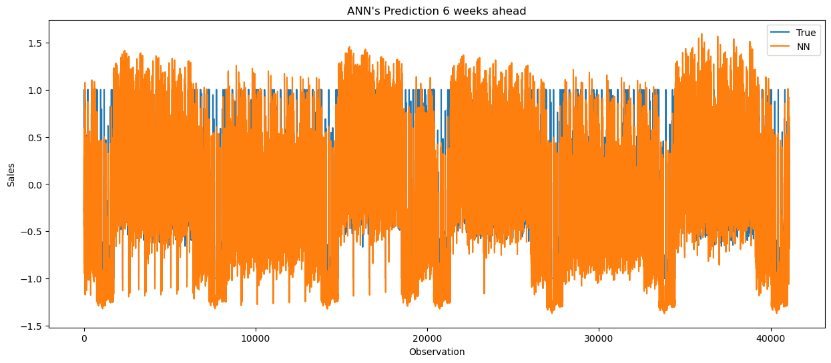
Prediction 6 weeks ahead
Likely corresponds to time-indexed datapoints (day-by-day or week-by-week).
The plot ranges approximately from 0 to 40,000, indicating a large volume of observations.
This scale implies that the data has been standardized or normalized before being fed into the ANN for better training convergence and performance.
Lines in the Plot
Blue Line (True Sales):
Represents the actual ground truth values from the test set.
It’s the benchmark for how well the model is performing.
Orange Line (Predicted Sales by ANN):
These are ANN’s predictions made six weeks ahead of the target dates.
It attempts to anticipate the actual trend as accurately as possible.

Slide 15
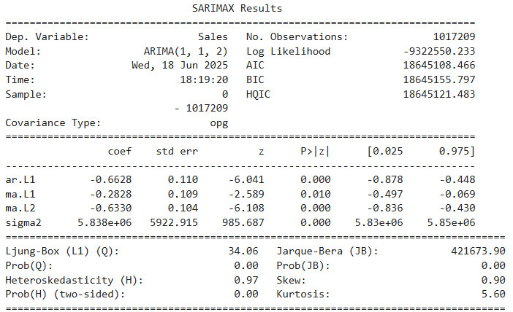
Summary of model
Layer (type) | Output Shape | Param #
dense (Dense) | (None, 12) | 348
dense_1 (Dense) | (None, 1) | 13
Total params: 1,085 (4.24 KB)
Trainable params: 361 (1.41 KB)
Non-trainable params: 0 (0.00 B)
Optimizer params: 724 (2.83 KB)

Slide 16
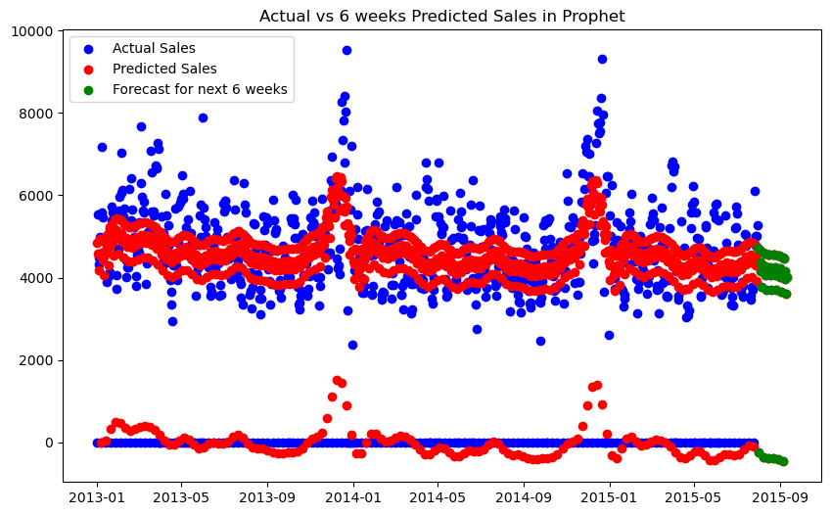
Actual vs 6 weeks Predicted Sales
1. X-Axis – Time Period: Covers sales data from January 2013 to September 2015, with a final portion for future predictions.
2. Y-Axis – Sales Volume: Sales range from 0 to 10,000 units, indicating significant variation—possibly due to seasonality, campaigns, or other market conditions.
The red points (Predicted Sales) align well with the blue points (Actual Sales) for most of the timeline, showing that the model has captured the trend reasonably well.
There are periodic spikes in actual sales, particularly around the beginning of each year (e.g., 2014 and 2015). These could be seasonal peaks possibly due to holidays or promotional periods.
The model (Prophet) has tried to capture this seasonality, though the extreme spikes aren't fully matched.
Weeks Forecast (Green Dots):
The short-term future forecast (green points) continues the existing trend and suggests moderate sales stability, without expecting any large surges or drops.

Slide 17
Streamlit Dashboard
Sales Forecasting Dashboard Overview
This interactive dashboard is designed to predict sales for a single store based on key input parameters. It allows users to:
🔢 Select Store ID: Choose the specific store for which sales need to be forecasted.
📅 Set Prediction Date: Choose a future date to get a sales prediction (e.g., 2025/06/25).
🏬 Define Store Features: Select the store type (e.g., type 'a', 'b', etc.), which helps tailor predictions based on store characteristics.
With a simple click on the "Predict Sales" button, users receive instant predictions, enabling better decision-making for inventory, staffing, and marketing strategies.
Input Parameters
These are the values that the user inputs to generate a sales prediction:
🆔 Store ID: The unique identification number for each store. In this case, Store ID "1" is selected. This ensures the prediction is specific to that store's past sales and behavior.
📅 Prediction Date: The future date for which the sales forecast is required. For instance, the date is set as 2025/06/25. This allows planning ahead for inventory, staffing, or promotions.
Benefits of Using This Dashboard
Ease of Use: Even non-technical users can generate forecasts by entering simple inputs.
Business Planning: Helps in preparing for expected demand, avoiding overstocking or understocking.
Customizable: Works for multiple store types and locations by changing Store ID and type.
Real-Time Results: Instant predictions enable fast decision-making.

Slide 18
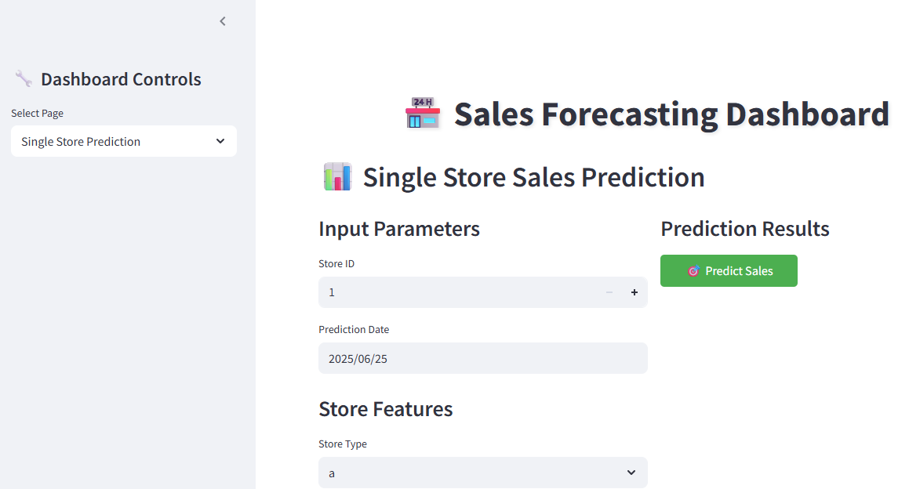

Slide 19
Conclusion
The sales forecasting project successfully implemented machine learning models to predict future sales across multiple retail stores.
The model captured seasonal trends, store-specific behaviors, and external factors to generate accurate forecasts.
A user-friendly interactive dashboard was developed to allow real-time predictions for any store on any selected date.
These insights empower businesses to:
Optimize inventory planning
Improve resource allocation
Design effective promotional strategies
Enhance overall operational efficiency
Provide both short-term (6-week) and long-term sales forecasts.
Future Scope
Integrate external factors like weather, marketing campaigns, and competitor pricing for even more accurate predictions.
Implement automated alerts and recommendation systems based on forecasted data.
Expand the model to handle real-time streaming data for dynamic forecasting.
Final Note
This sales forecasting system bridges the gap between raw sales data and business intelligence, helping companies move from reactive to proactive planning. It is a powerful tool for retail growth, built on data science, automation, and strategic foresight.

Slide 20
Thank You

